Slide 1
Collections and inversional symmetry 2

Slide 2
Symmetrical Scales
Even and Odd Whole Tone

Slide 3
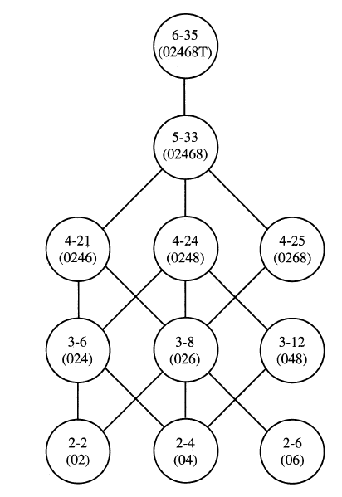

Slide 4
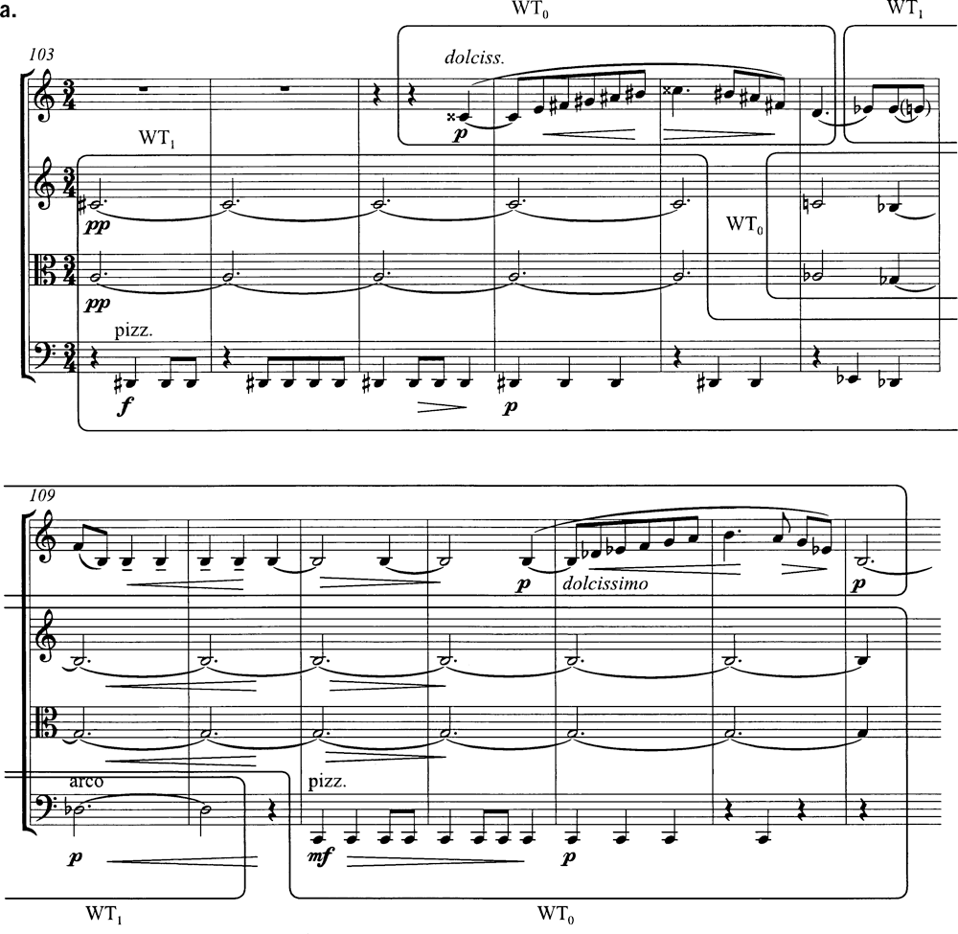
Bartók, String Quartet, No. 1, ii

Slide 5
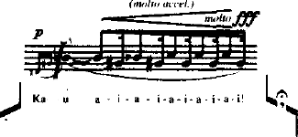
Crumb, Ancient Voices of Children, V, WT0

Slide 6
The hexatonic scale S-m3-S-m3-S-m3

Slide 7
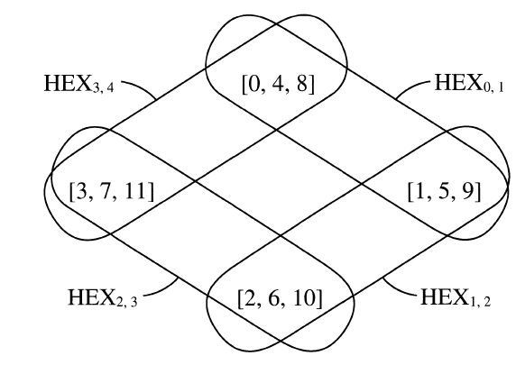
The hexatonic scale transpositional combination

Slide 8
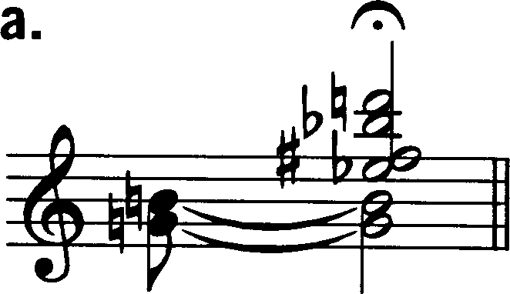
Schoenberg, Little Piano Pieces, Op. 19, No. 2
Bartók, String Quartet No. 2, I, coda

Slide 9
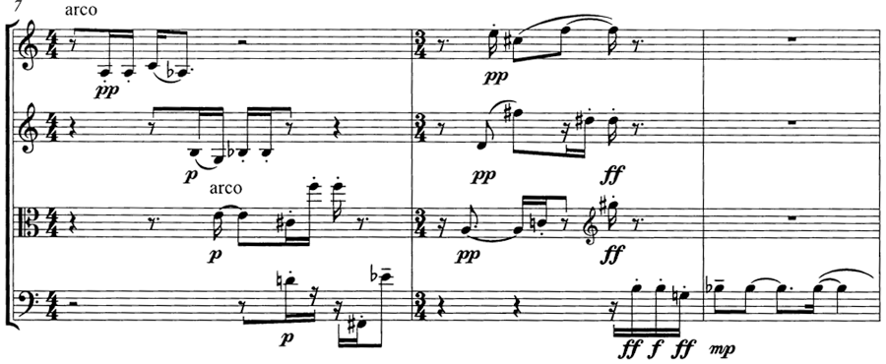
Babbitt,
String Quartet No. 2, I

Slide 10
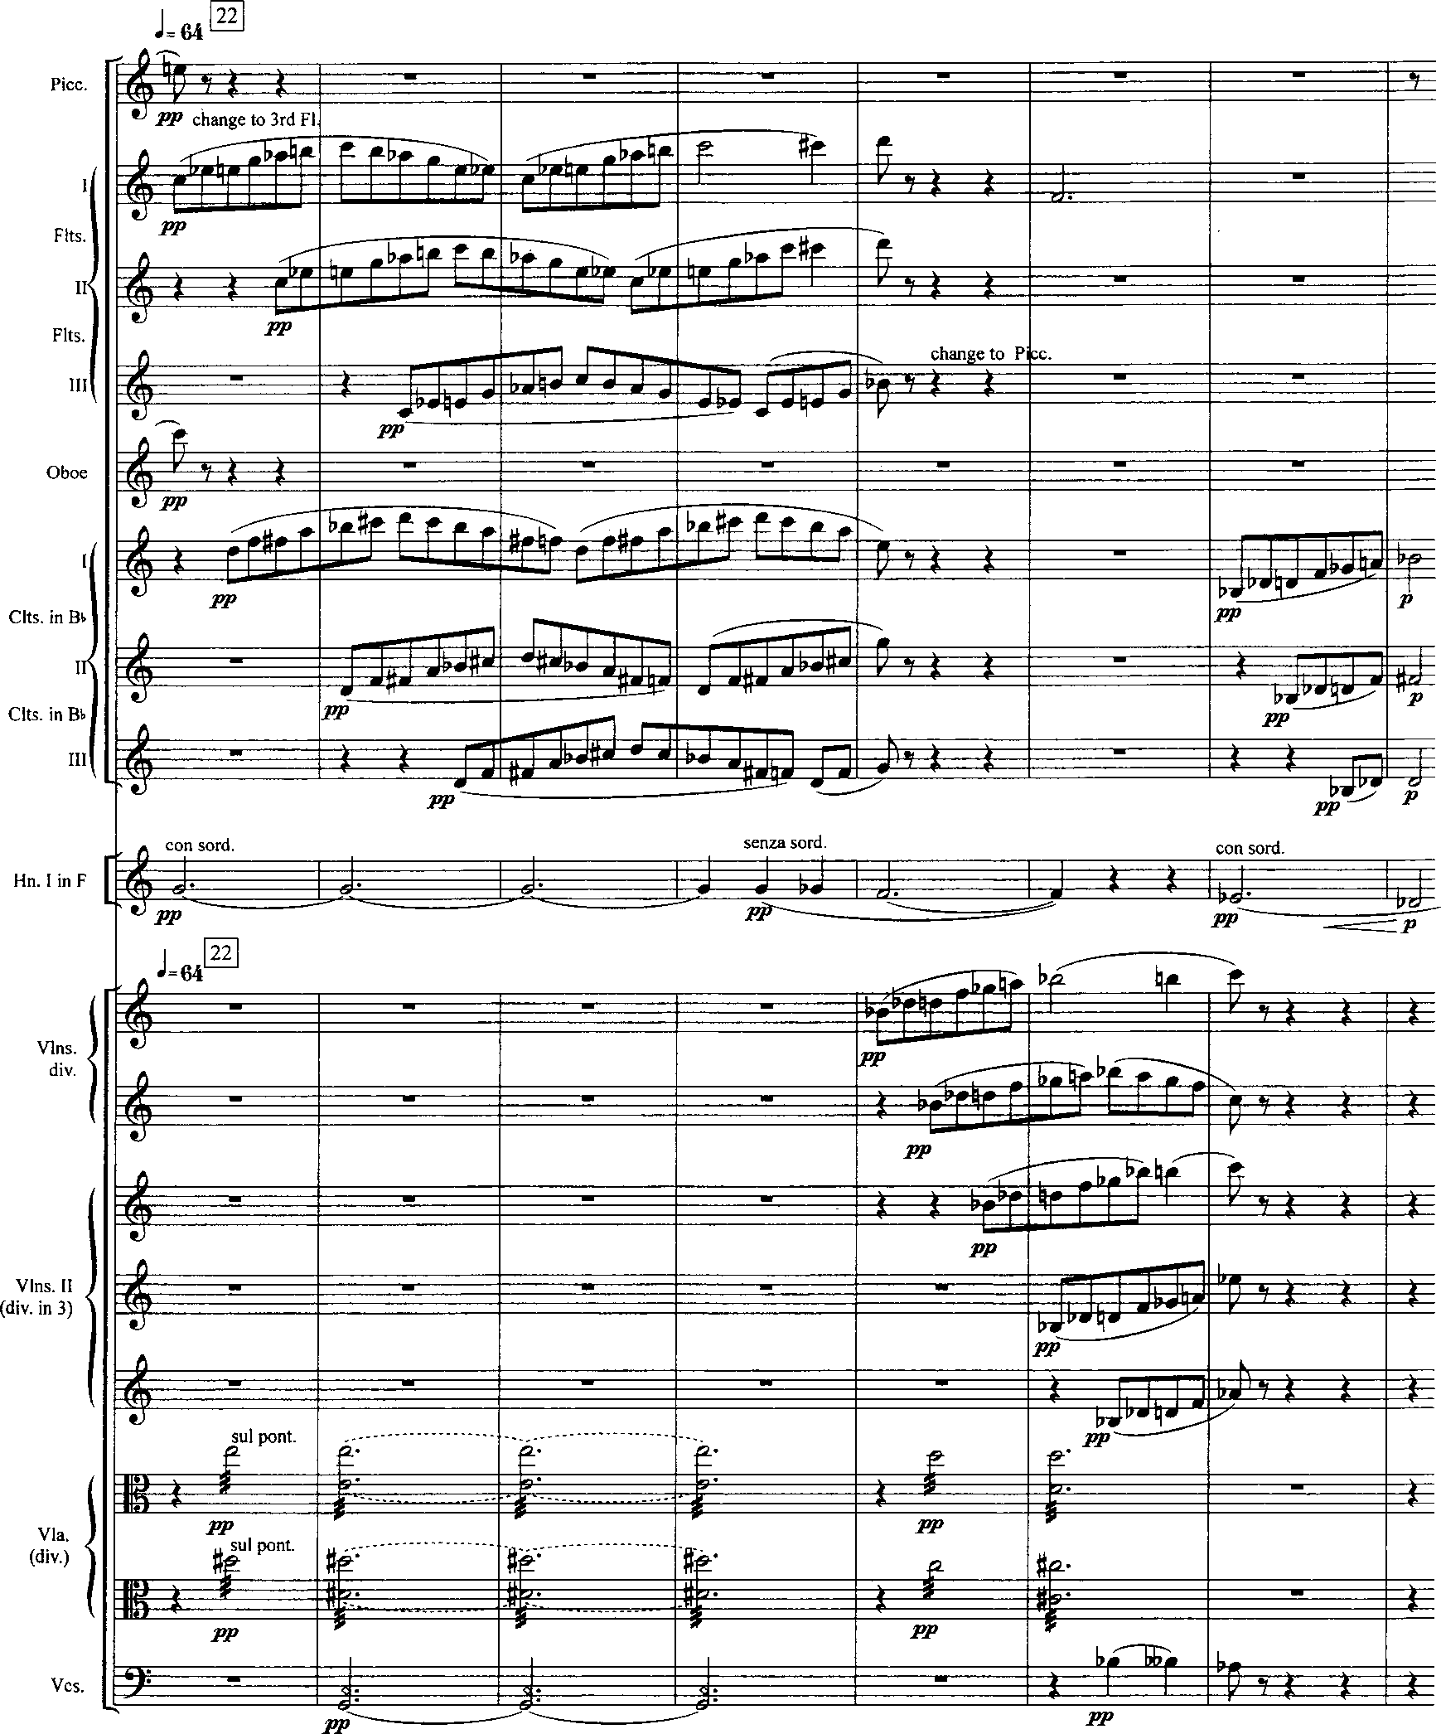
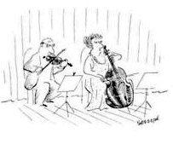
Hex (3,4)B
Bartók,
Concerto for
Orchestra III,
22-29
What collections
can you find?
Hex (1,2) B

Slide 11
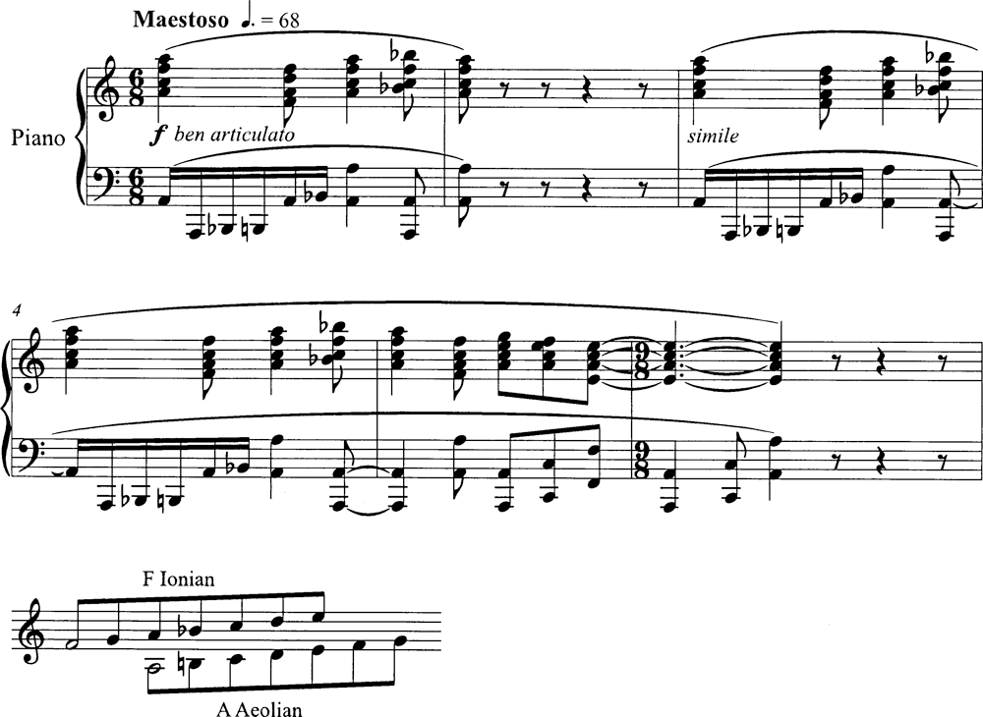
Stravinsky, Serenade in A, collectional interaction

Slide 12
Bartók, “Song of the Harvest”
Five sections
1-5,
6-15,
16-20,
21-29,
30-33

Slide 13
Phrase 1 = OCT(2,3)B

Slide 14
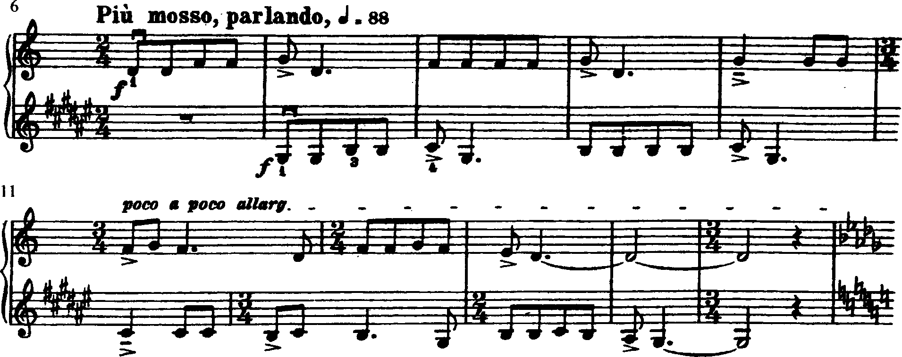
Phrase 2 = OCT(1,2)B

Slide 15
Phrase 3 = OCT(1,2)B

Slide 16
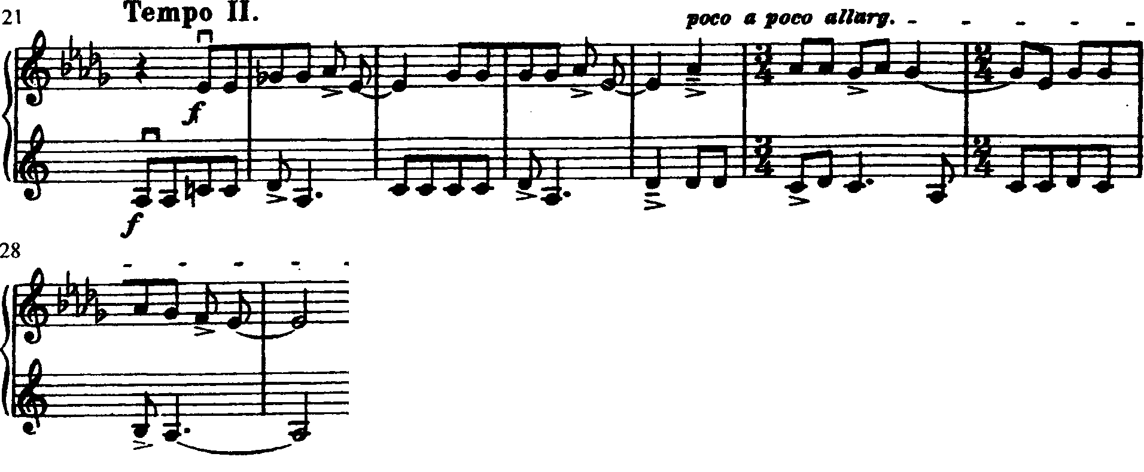
Phrase 4 = OCT(2,3)B

Slide 17
Phrase 5 = A^{b} Dorian

Slide 18
Thematic Design
Sections 1, 3, 5 = a;
Sections 2, 4 = b

Slide 19
Tonal Design
Sections 1, 4 = (OCT(2,3)B and D#-A (A-Eb)
Sections 2, 3 = (OCT(1,2)B and G#-D & B-F
Section 5 =Ab-Eb synthesis

Slide 21
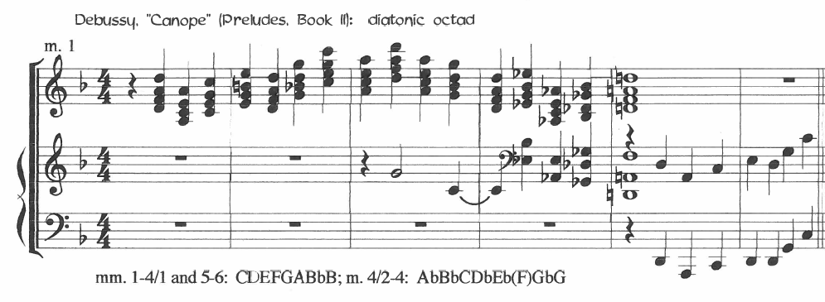

Slide 23
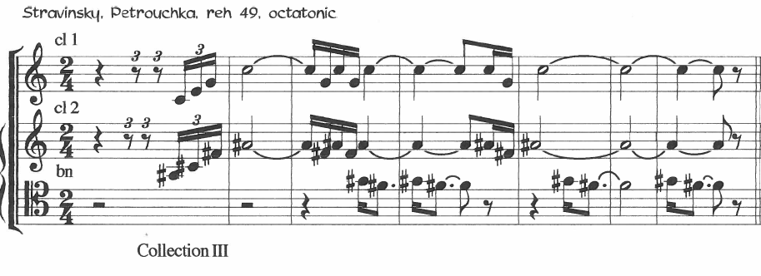

Slide 24
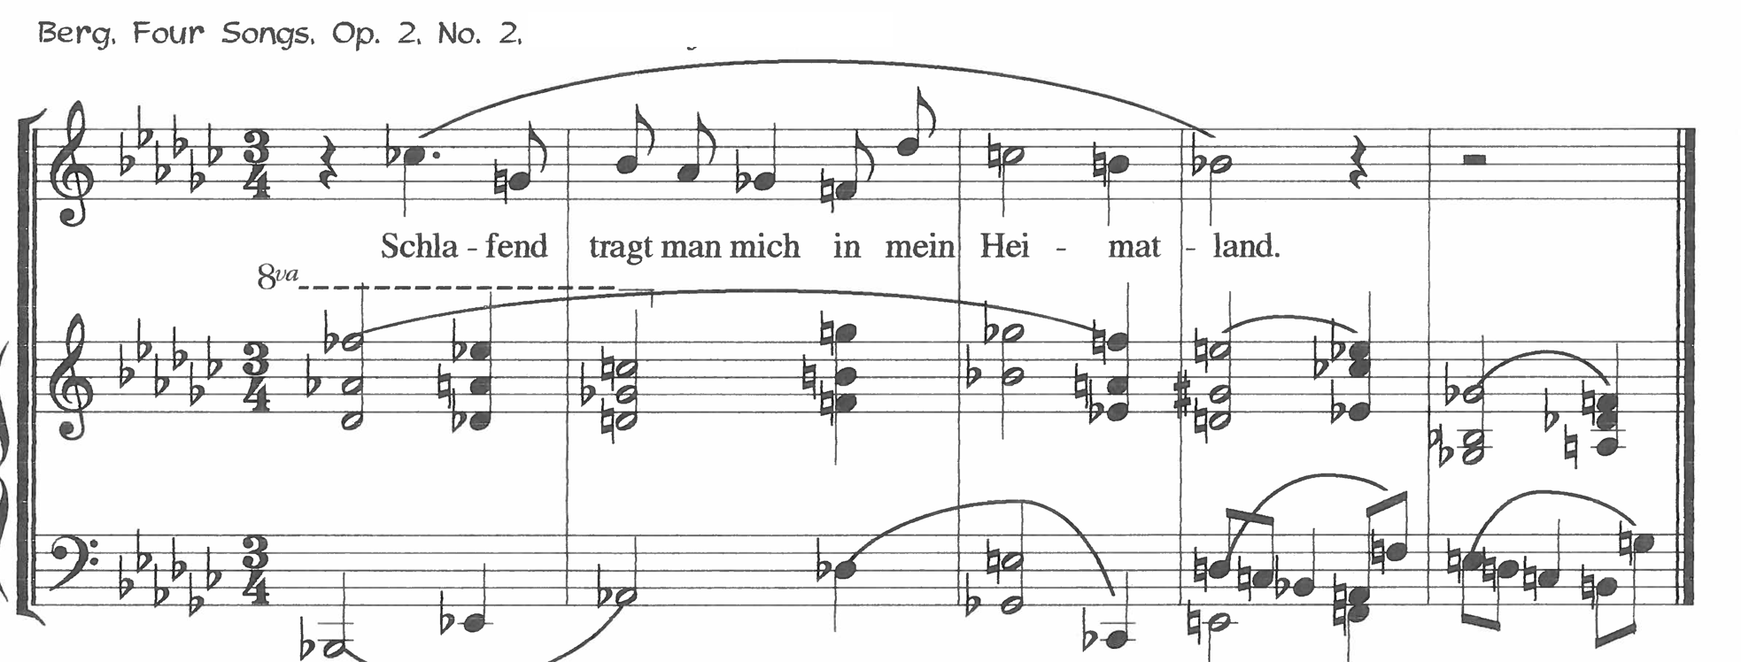

Slide 25
